Slide 2
Contents
Introduction to SPICE
Commonly used SPICE Commands
Resistive Divider
Inverter Characteristics
Static Logic Circuit
Dynamic Logic Circuits (Transmission Gate)
Self-Learning (DAC Examples)

Slide 3
Contents
Introduction to WiinSPICE
The simulation program with an integrated circuit emphasis (SPICE)
“*.cir, *.sp, or *.spi” (among others) extensions.
Free tool

Slide 4
Contents
Commonly used Commands
.OP (Operating Point)
.TF (Transfer Function)
.dc (DC Analysis)
.tran (Transient Analysis)
.ac (AC Analysis)
SIN (Sine Wave input)
Pulse (Pulse Input)
PWL (Piece-Wise Linear Source)
.subckt (Sub-Circuit)

Slide 5
Contents
Sample SPICE Code
*#destroy all
*#run
*#print all
.op
Vin 1 0 DC 1
R1 1 2 1k
R2 2 0 2k
.end
Circuit Description
Analysis to be carried out
Print or Plot the results

Slide 6
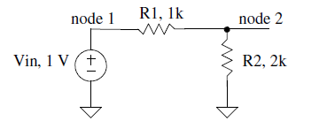
Voltage Divider

Slide 7
Voltage Divider
.op (operating point analysis)
*#destroy all
*#run
*#print all
.op
Vin 1 0 DC 1
R1 1 2 1k
R2 2 0 2k
.end

Slide 8
Voltage Divider
.op (operating point analysis)
v(1) = 1.000000e+00
v(2) = 6.666667e-01
vin#branch = -3.33333e-04
v(1) = 1V
v(2) = 6.66 V
vin#branch = -333 μA

Slide 9
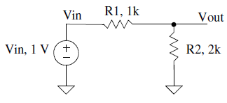
Voltage Divider
.op (operating point analysis)
*#destroy all
*#run
*#print all
.op
Vin Vin 0 DC 1
R1 Vin Vout 1k
R2 Vout 0 2k
.end

Slide 10
Voltage Divider
*#destroy all
*#run
*#print all
.TF V(Vout,0) Vin
Vin Vin 0 DC 1
R1 Vin Vout 1k
R2 Vout 0 2k
.end
Transfer Function
.TF V(Vout,0) Vin
transfer_function = 6.666667e-01
output_impedance_at_v(vout,0) = 6.666667e+02
vin#input_impedance = 3.000000e+03

Slide 11
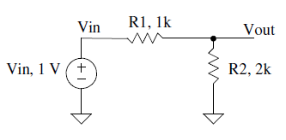
Voltage Divider
DC Analysis
.dc Vin 0 1 1m
*#destroy all
*#run
*#plot Vin Vout
.dc Vin 0 1 1m
Vin Vin 0 DC 1
R1 Vin Vout 1k
R2 Vout 0 2k
.end

Slide 12
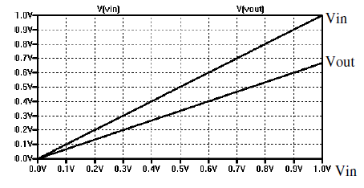
Voltage Divider
DC Analysis

Slide 13
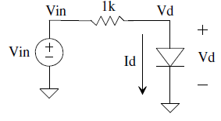
Voltage Divider with Diode
Diode IV Curve
*#destroy all
*#run
*#let ID= -Vin#branch
*#plot ID
.dc Vin 0 1 1m
Vin Vin 0 DC 1
R1 Vin Vd 1k
D1 Vd 0 mydiode
.model mydiode D
.end

Slide 14
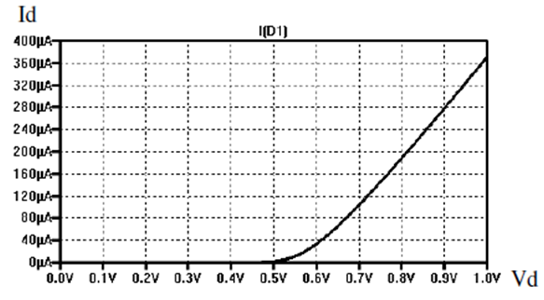
Voltage Divider with Diode
Diode IV Curve

Slide 15
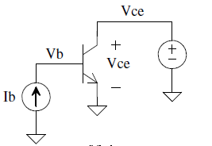
Dual Loop
*#destroy all
*#run
*#let Ic=-Vce#branch
*#plot Ic
.dc Vce 0 5 1m Ib 5u 25u 5u
Vce Vce 0 DC 0
Ib 0 Vb DC 0
Q1 Vce Vb 0 myNPN
.model myNPN NPN
.end

Slide 16
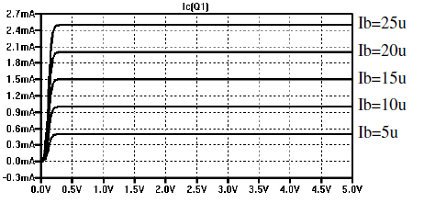
Dual Loop

Slide 17
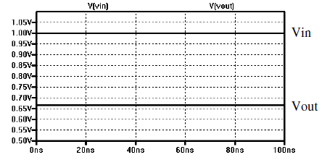
Voltage Divider Transient Analysis
*#destroy all
*#run
*#plot vin vout
.tran 100p 100n
Vin Vin 0 DC 1
R1 Vin Vout 1k
R2 Vout 0 2k
.end
Transient Analysis
.tran tstep tstop <tstart> <tmax> <uic>

Slide 18
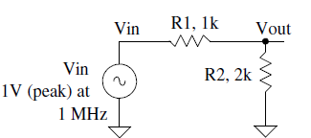
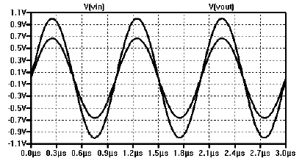
The SIN Source
Voltage Divider SINE Input
SIN Vo Va freq <td> <theta>
*#destroy all
*#run
*#plot vin vout
.tran 1n 3u
Vin Vin 0 DC 0 SIN 0 1 1MEG
R1 Vin Vout 1k
R2 Vout 0 2k
.end

Slide 19
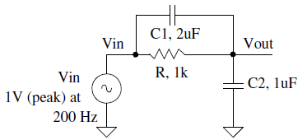
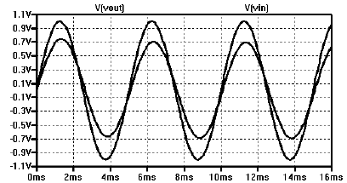
Voltage Divider SINE Input and Capacitive Load
*#destroy all
*#run
*#plot vin vout
.tran 10u 16m
Vin Vin 0 DC 0 SIN 0 1 200
R1 Vin Vout 1k
C1 Vin Vout 2u
C2 Vout 0 1u
.end

Slide 20
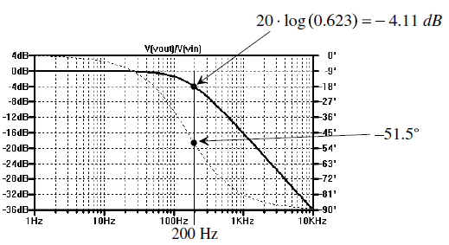
Voltage Divider SINE Input and Capacitive Load
AC Analysis
.ac dec nd fstart fstop
*#destroy all
*#run
*#plot db(vout/vin)
*#set units=degrees
*#plot ph(vout/vin)
.ac dec 100 1 10k
Vin Vin 0 DC 0 SIN 0 1 200 AC 1
R1 Vin Vout 1k
CL Vout 0 1u
.end

Slide 21
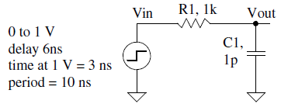
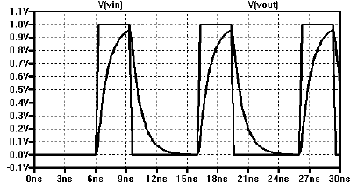
Pulse Input and Capacitive Load
Pulse Statement
pulse vinit vfinal td tr tf pw per
*#destroy all
*#run
*#plot vin vout
.tran 100p 30n
Vin Vin 0 DC 0 pulse 0 1 6n 0 0 3n 10n
R1 Vin Vout 1k
C1 Vout 0 1p

Slide 22
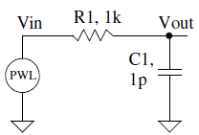
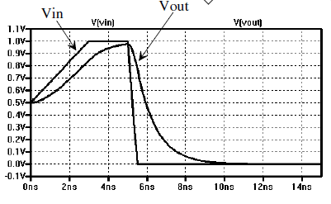
Pulse Input and Capacitive Load
Piece-Wise Linear (PWL) Source
pwl t1 v1 t2 v2 t3 v3 ... <rep>
pwl 0 0.5 3n 1 5n 1 5.5n 0 7n 0

Slide 23
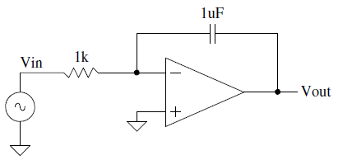
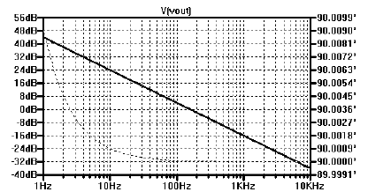
Sub Circuit Example
An integrator
*#destroy all
*#run
*#plot db(vout/vin)
*#set units=degrees
*#plot ph(vout/vin)
.ac dec 100 1 10k
Vin Vin 0 DC 1 AC 1
Rin Vin vm 1k
Cf Vout vm 1u
X1 Vout 0 vm Ideal_op_amp
.subckt Ideal_op_amp Vout Vp Vm
G1 Vout 0 Vm Vp 1MEG
RL Vout 0 1
.ends
.end

Slide 24
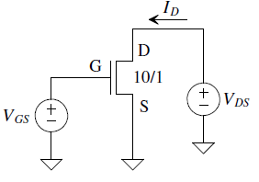
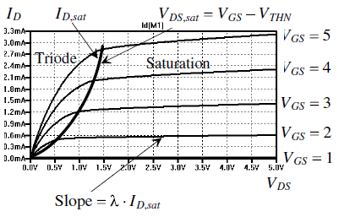
MOSFET Operation
Characteristics of a long-channel NMOS device.
*#destroy all
*#run
*#let ID=-VDS#branch
*#plot ID
.option scale=1u
.dc VDS 0 5 1m VGS 0 5 1
VDS VDS 0 DC 5
VGS VGS 0 DC 0
M1 VDS VGS 0 0 N_1u L=1 W=10
.include cmosedu_models.txt
.end

Slide 25
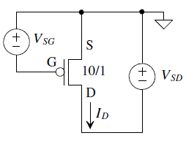
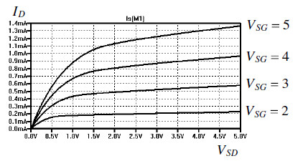
MOSFET Operation
Characteristics of a long-channel PMOS device.
*#destroy all
*#run
*#let ID=-VSD#branch
*#plot ID
.option scale=1u
.dc VSD 0 5 1m VSG 0 5 1
VSD 0 VSD DC 5
VSG 0 VSG DC 0
M1 VSD VSG 0 0 P_1u L=1 W=10
.include cmosedu_models.txt
.end

Slide 26
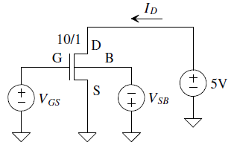
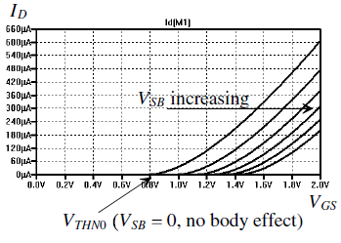
MOSFET Operation
Threshold voltage and body effect.
*#destroy all
*#run
*#let ID=-VDS#branch
*#plot ID
.option scale=1u
.dc VGS 0 2 1m VSB 0 5 1
VDS VD 0 DC 5
VGS VGS 0 DC 0
VSB 0 VSB DC 0
M1 VD VGS 0 VSB N_1u L=1 W=10
.include cmosedu_models.txt
.end

Slide 27
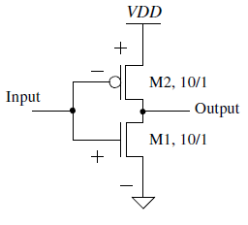
*#destroy all
*#run
*#let Icross=-i(vdd)
*#plot Icross
*#plot vout
.option scale=1u
.dc vin 0 5 1m
vdd vdd 0 DC 5
Vin vin 0 DC 0
M1 vout vin 0 0 N_1u L=1 W=10
M2 vout vin vdd vdd P_1u L=1 W=10
.include cmosedu_models.txt
.end
Inverter Operation

Slide 28
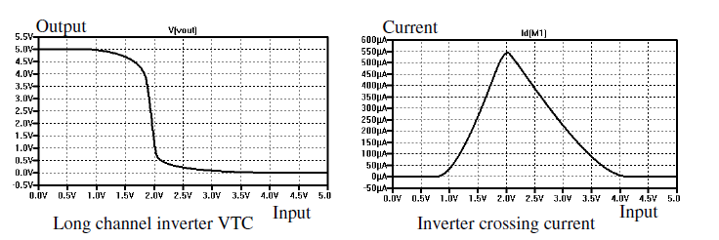
Inverter Operation

Slide 29
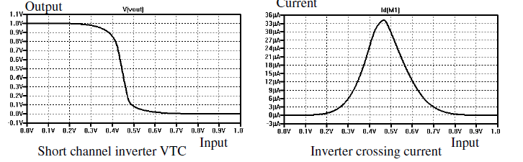
Inverter Operation
.option scale=50n
.dc vin 0 1 1m
vdd vdd 0 DC 1
M1 vout vin 0 0 N_50n L=1 W=10
M2 vout vin vdd vdd P_50n L=1 W=10
.include cmosedu_models.txt
.end

Slide 30
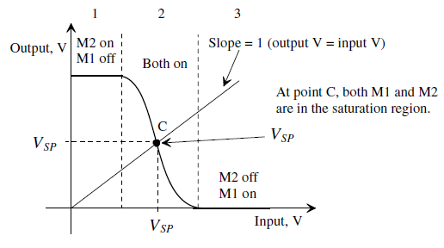
Inverter Operation:: Switching Point
*#destroy all
*#run
*#let Icross=-i(vdd)
*#plot Icross
*#plot vout
*#plot vin, vout
.option scale=50n
.dc vin 0 1 1m
vdd vdd 0 DC 1
Vin vin 0 DC 0
M1 vout vin 0 0 N_50n L=1 W=10
M2 vout vin vdd vdd P_50n L=1 W=20
.include cmosedu_models.txt
.end

Slide 31
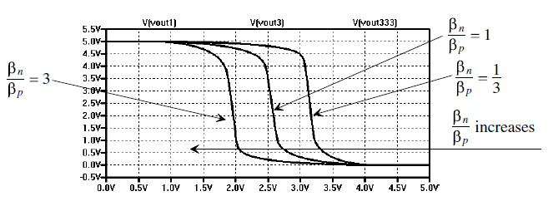
Inverter Operation:: Beta Effects

Slide 32
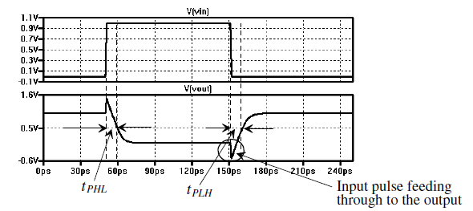
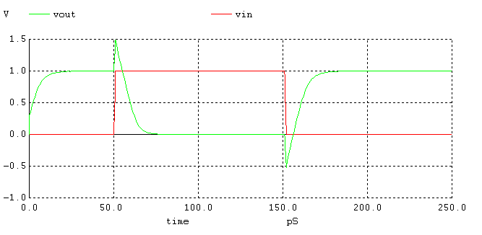
Inverter Operation:: Intrinsic Delay

Slide 33
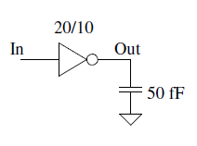
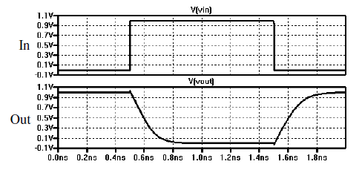
Inverter Operation:: with Capacitive Load

Slide 34
*#destroy all
*#let cap = 25f
*#while cap <= 125f
*# alter @Cload[capacitance] = cap
*# run
*# let cap = cap + 25f
*#end
** plot load C from 25f to 125f
*#plot tran1.vout tran2.vout tran3.vout tran4.vout tran5.vout vin
.option scale=50n
.tran 10p 2n UIC
vdd vdd 0 DC 1
Vin vin 0 DC 0 pulse 0 1 500p 0 0 1n 2n
M1 vout vin 0 0 N_50n L=1 W=10
M2 vout vin vdd vdd P_50n L=1 W=20
Cload vout 0 50f
.include cmosedu_models.txt
.end
Inverter Operation:: with Capacitive Load

Slide 35
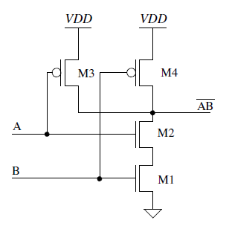
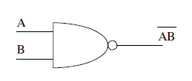
Static Logic:: NAND

Slide 36
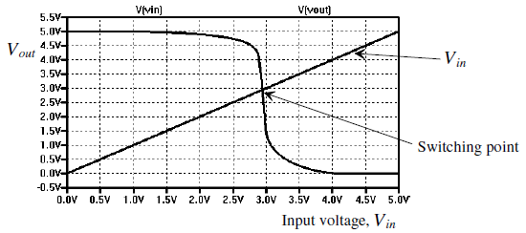
Static Logic:: NAND

Slide 37
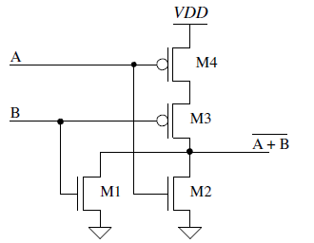

Static Logic:: NOR

Slide 38
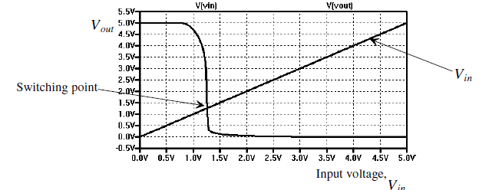
Static Logic:: NOR

Slide 39
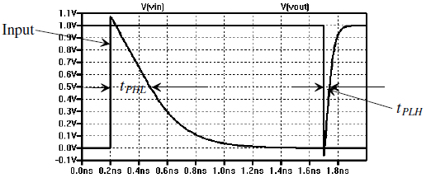
Static Logic:: NAND (3 Input) Propagation Delay

Slide 40
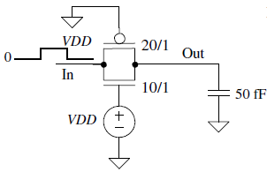
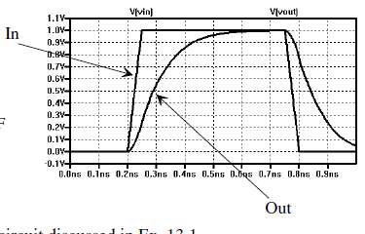
Static Logic:: Transmission Gate
x1 vin out vdd 0 vdd TG
cl out 0 50f
.subckt TG in out s sbar VDD
M1 in s out 0 N_50n L=1 W=10
M2 in sbar out vdd P_50n L=1 W=20
.ends

Slide 41
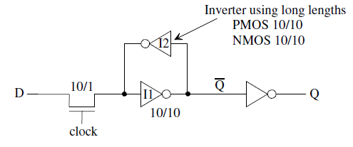
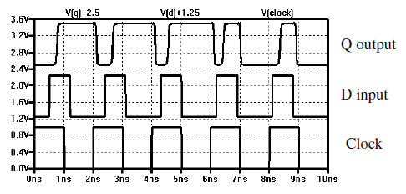
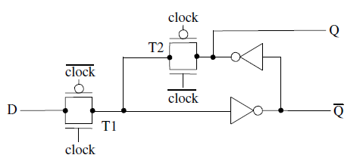
Dynamic Logic:: Transmission Gate based Level Sensitive Latch

Slide 42
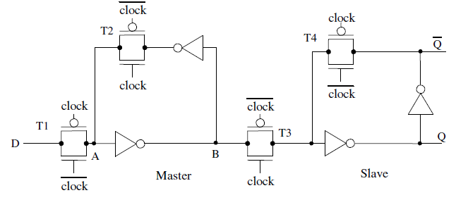
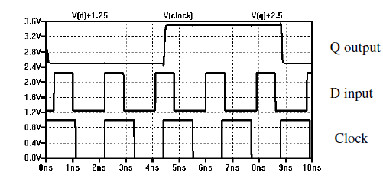
Dynamic Logic:: Transmission Gate based Edge Sensitive FF

Slide 43
Links
https://www.u-cursos.cl/usuario/9553d43f5ccbf1cca06cc02562b4005e/mi_blog/r/CMOS_Circuit_Design__Layout__and_Simulation__3rd_Edition.pdf
https://github.com/kamarajvlsi/WinSPICE
http://www.winspice.com/
http://cmosedu.com/cmos1/winspice/winspice.pdf

